Slide 1

Unit-IV
MGN-502
Motivation,
Early and Contemporary Theories
p. b. Narendra Kiran
Assistant professor

Slide 2

Motivation
Learning outcome-
be able to understand the importance of motivation and its theories.

Slide 3
Motivation
The term “motivation” can be traced out from a Latin word ‘movere’, which means to move.
Motivation is the process that initiates, guides, and maintains goal-oriented behaviors.
Motivation is core of management.

Slide 4
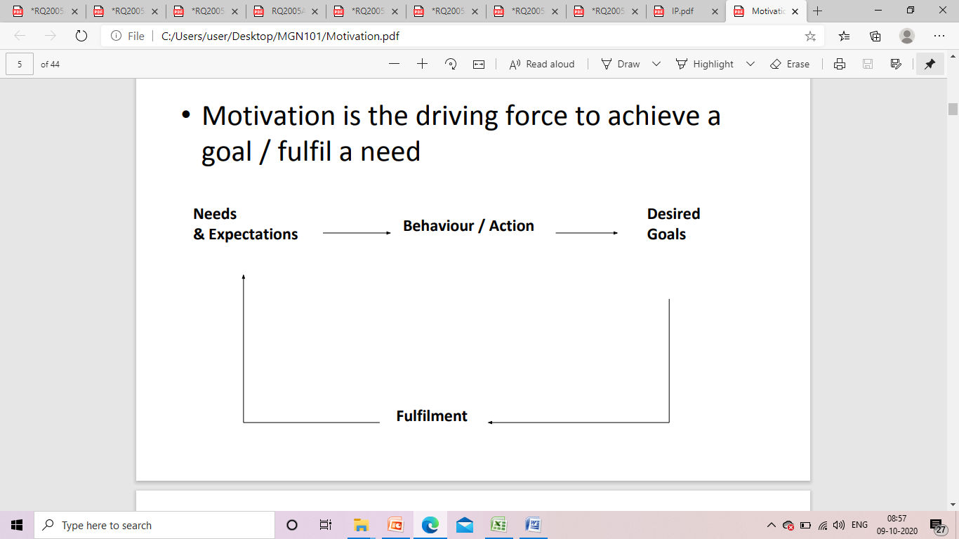
Motivation

Slide 5
Process of motivation
Drive/Need: for something
Tension: creates for something
Instrumental Behavior: behave in particular manner
Reduction of need : satisfied of need
Goal: leads to achievement
Relief: temporary period of relief

Slide 6
Nature of Motivation
It is a continuous process
It is goal oriented
It can be financial and/or non-financial
It can be positive or negative
It is complex by nature

Slide 7
Importance of motivation
Makes impossible things possible
High performance
Reduced employee turnover and absenteeism
Effective utilization of resources
Achievement of organizational goals
Improves efficiency of employees
Better and cordial industrial relations

Slide 8
Types of motivation
❖ Intrinsic Motivation
❖ Extrinsic Motivation
❖ Financial Motivation
❖ Non-Financial Motivation
❖ Positive Motivation
❖ Negative Motivation

Slide 9
……….
Intrinsic motivation: This is when motivation comes from "internal" factors to meet personal needs.
We do things we do because we enjoy them, not because we have to. Intrinsic means internal or inside of yourself.

Slide 10
………
Extrinsic motivation: This is when motivation comes from "external" factors that are given or controlled by others. Salary or praise are good examples.
This type of motivation is everywhere and frequently used within society.

Slide 11
……….
Positive motivation (rewards)
It is the type of motivation that you use when you perform an activity to gain a reward that usually lies in the future.
Negative motivation (pain-avoidance)
It is the type of motivation that you use when you perform an activity to avoid the pain that may result from not doing it. For instance, a student who studies hard not to fail is negatively motivating himself.

Slide 12
Quiz
Which one of the following is not true?
Motivation is complex process
Motivation is goal oriented
Motivation is the core of management
Motivation always comes from internal factors

Slide 13
Theories of Motivation

Slide 14
Maslow's Theory of Needs Hierarchy
Maslow's hierarchy of needs is a motivational theory in psychology comprising a five-tier model of human needs, often depicted as hierarchical levels within a pyramid.
From the bottom of the hierarchy upwards, the needs are: physiological, safety, social, self-esteem and self-actualization.
https://www.youtube.com/watch?v=UxdvcAJFRnc

Slide 15
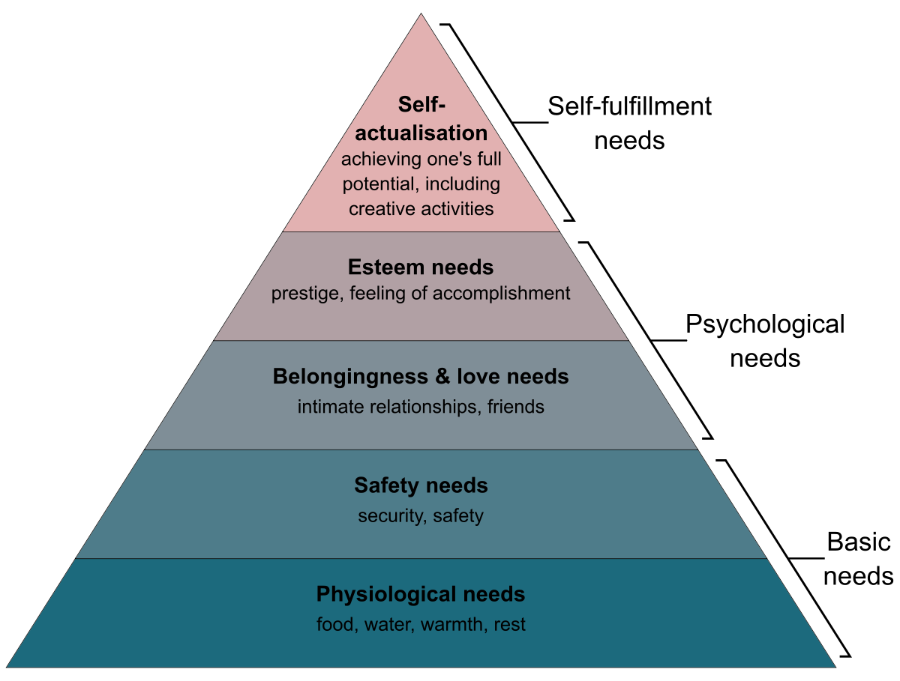

Slide 16
Criticisms of Maslow's Hierarchy of Needs
The needs may not follow a definite hierarchical order.
For example, even if safety need is not satisfied, the social need may emerge.
The level of motivation may be permanently lower for some people.

Slide 17
Herzberg’s Two Factor Theory of Motivation -
Two Factor Theory, argues that there are two factors that an organization can adjust to influence motivation in the workplace. The factors are-
Motivating factors: Which can encourage employees to work harder.
Hygiene factors: These won’t encourage employees to work harder but their absence will cause them to become demotivated.

Slide 18
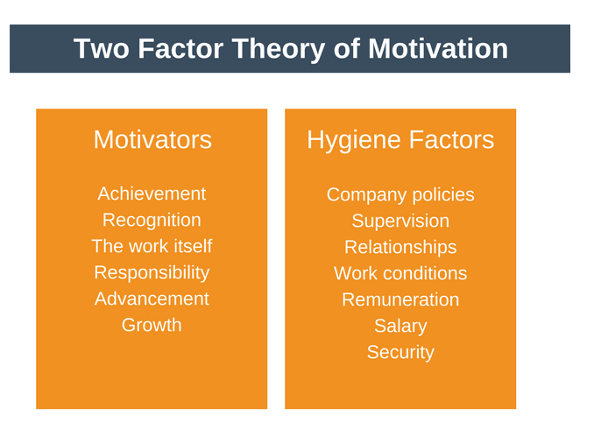

Slide 19
Motivating Factors
Achievement: A job must give an employee a sense of achievement. This will provide a proud feeling of having done something difficult but worthwhile.
Recognition: A job must provide an employee with praise and recognition of their successes. This recognition should come from both their superiors and their peers.
The work itself: The job itself must be interesting, varied, and provide enough of a challenge to keep employees motivated.

Slide 20
……….
Responsibility: Employees should “own” their work. They should hold themselves responsible for this completion and not feel as though they are being micromanaged.
Advancement: Promotion opportunities should exist for the employee.
Growth: The job should give employees the opportunity to learn new skills. This can happen either on the job or through more formal training.

Slide 21
Hygiene factors
Company policies: These should be fair and clear to every employee. They must also be equivalent to those of competitors.
Supervision: Supervision must be fair and appropriate. The employee should be given as much autonomy as is reasonable.
Relationships: There should be no tolerance for bullying. A healthy, amiable, and appropriate relationship should exist between peers, superiors, and subordinates.

Slide 22
………….
Work conditions: Equipment and the working environment should be safe, fit for purpose, and hygienic.
Salary: The pay structure should be fair and reasonable. It should also be competitive with other organizations in the same industry.
Security: It is important that employees feel that their job is secure and they are not under the constant threat of being laid-off.

Slide 23
The Four Stages
High Hygiene and High Motivation: This is the ideal situation and the one which every manager should strive for. Here, all employees are motivated and have very few grievances.
Low Hygiene and Low Motivation: This is obviously a bad situation for an organization or team to find itself in. Here, employees aren’t motivated and the hygiene factors are not up to scratch.

Slide 24
………..
High Hygiene and Low Motivation: In this situation, employees have few grievances but they are not highly motivated. An example working condition is good but the work isn’t very interesting.
Low Hygiene and High Motivation: employees are highly motivated but they have a lot of grievances. A typical example is where the work is exciting but the pay and working conditions are behind competitors.

Slide 25
Strategies to motivate employees
There is a two-step process to use the Two Factor Theory model to increase the motivation of your team.
Eliminate job hygiene stressors.
Boost job satisfaction

Slide 26
MCQs
1. Who has given the hierarchy of needs theory of motivation?
Abraham Maslow
David McClelland
Victor Vroom
Frederick Herzberg

Slide 27
…………
Which among the following is not one of the needs of human being as par needs theory of motivation?
Safety need
Social need
Political need
Esteem need

Slide 28
Theory X and Theory Y (Douglas McGregor)
Theory X
Assumes that employees dislike work, lack ambition, avoid responsibility, and must be directed and coerced to perform.
Theory Y
Assumes that employees like work, seek responsibility, are capable of making decisions, and exercise self-direction and self-control when committed to a goal.

Slide 29
McGregor’s Theory X & Y
Theory X
*Managers are pessimistic
about workers’
capabilities.
*Managers believe people
dislike work, seek to
avoid responsibility, and
are not ambitious.
*Employees must be
closely supervised.
Theory Y
*Managers are more
optimistic about workers’
capabilities.
*Managers believe people
enjoy work, willingly
accept responsibility,
exercise self-control,
have the capacity to
innovate, and work

Slide 30
McGregors Theory of X & Y
Theory X (bureaucratic & authoritarian ) | Theory Y
Average person dislikes work | People are by nature not lazy & unreliable
Most people are not ambitious and little capacity for creativity & innovation | They enjoy work, show initiative & imagination in self direction and self control
Needs to be directed and do not take responsibility | Motivations occurs at the social esteem, and self actualisation levels and also at physiological and security levels
Necessary to use strict controls, threats, constant pressure, coercion, persuasion or punishment | People can be self directed and can be creative ast work if properly motivated

Slide 31
ERG Theory (Clayton Alderfer)
ERG Theory
There are three groups of core needs: existence, relatedness, and growth.
Core Needs
Existence: provision of basic material requirements. Physiological and safety needs
Relatedness: desire for relationships. Interpersonal relationship
Growth: desire for personal development. Self improvement
Concepts:
More than one need can be operative at the same time.
If a higher-level need cannot be fulfilled, the desire to satisfy a lower-level need increases.

Slide 32
Alderfer’s ERG Theory
Need Growth Needs Need
Progression Regression
less developed state
Relatedness Needs
Existence Needs
Notes:
4

Slide 33
ERG Theory
ERG Theory states that at a given point of time, more than one need may be operational.
For instance- when growth need aggravates, then an individual might be motivated to accomplish the relatedness need and if there are issues in accomplishing relatedness needs, then he might be motivated by the existence needs.

Slide 34
Contemporary Theories of Motivation

Slide 35
GOAL SETTING THEORY
Propounded by Edwin Locke
Goals shows the direction and path to be followed.
Features
1. Willingness to work towards achieving a particular goal is the root of job motivation.
Specific and clear goals leads to greater results
Goals sets should be realistic as well as challenging.

Slide 36
………..
Feedback on outputs gives direction
Goal setting plays an important role in making a goal acceptable and it leads to more involvement.

Slide 37
EQUITY THEORY
John Stacey Adams-1963
Employees try to maintain balance between input that they bring in to the job with the output that they receive.
Fair treatment is the root of motivation.

Slide 38
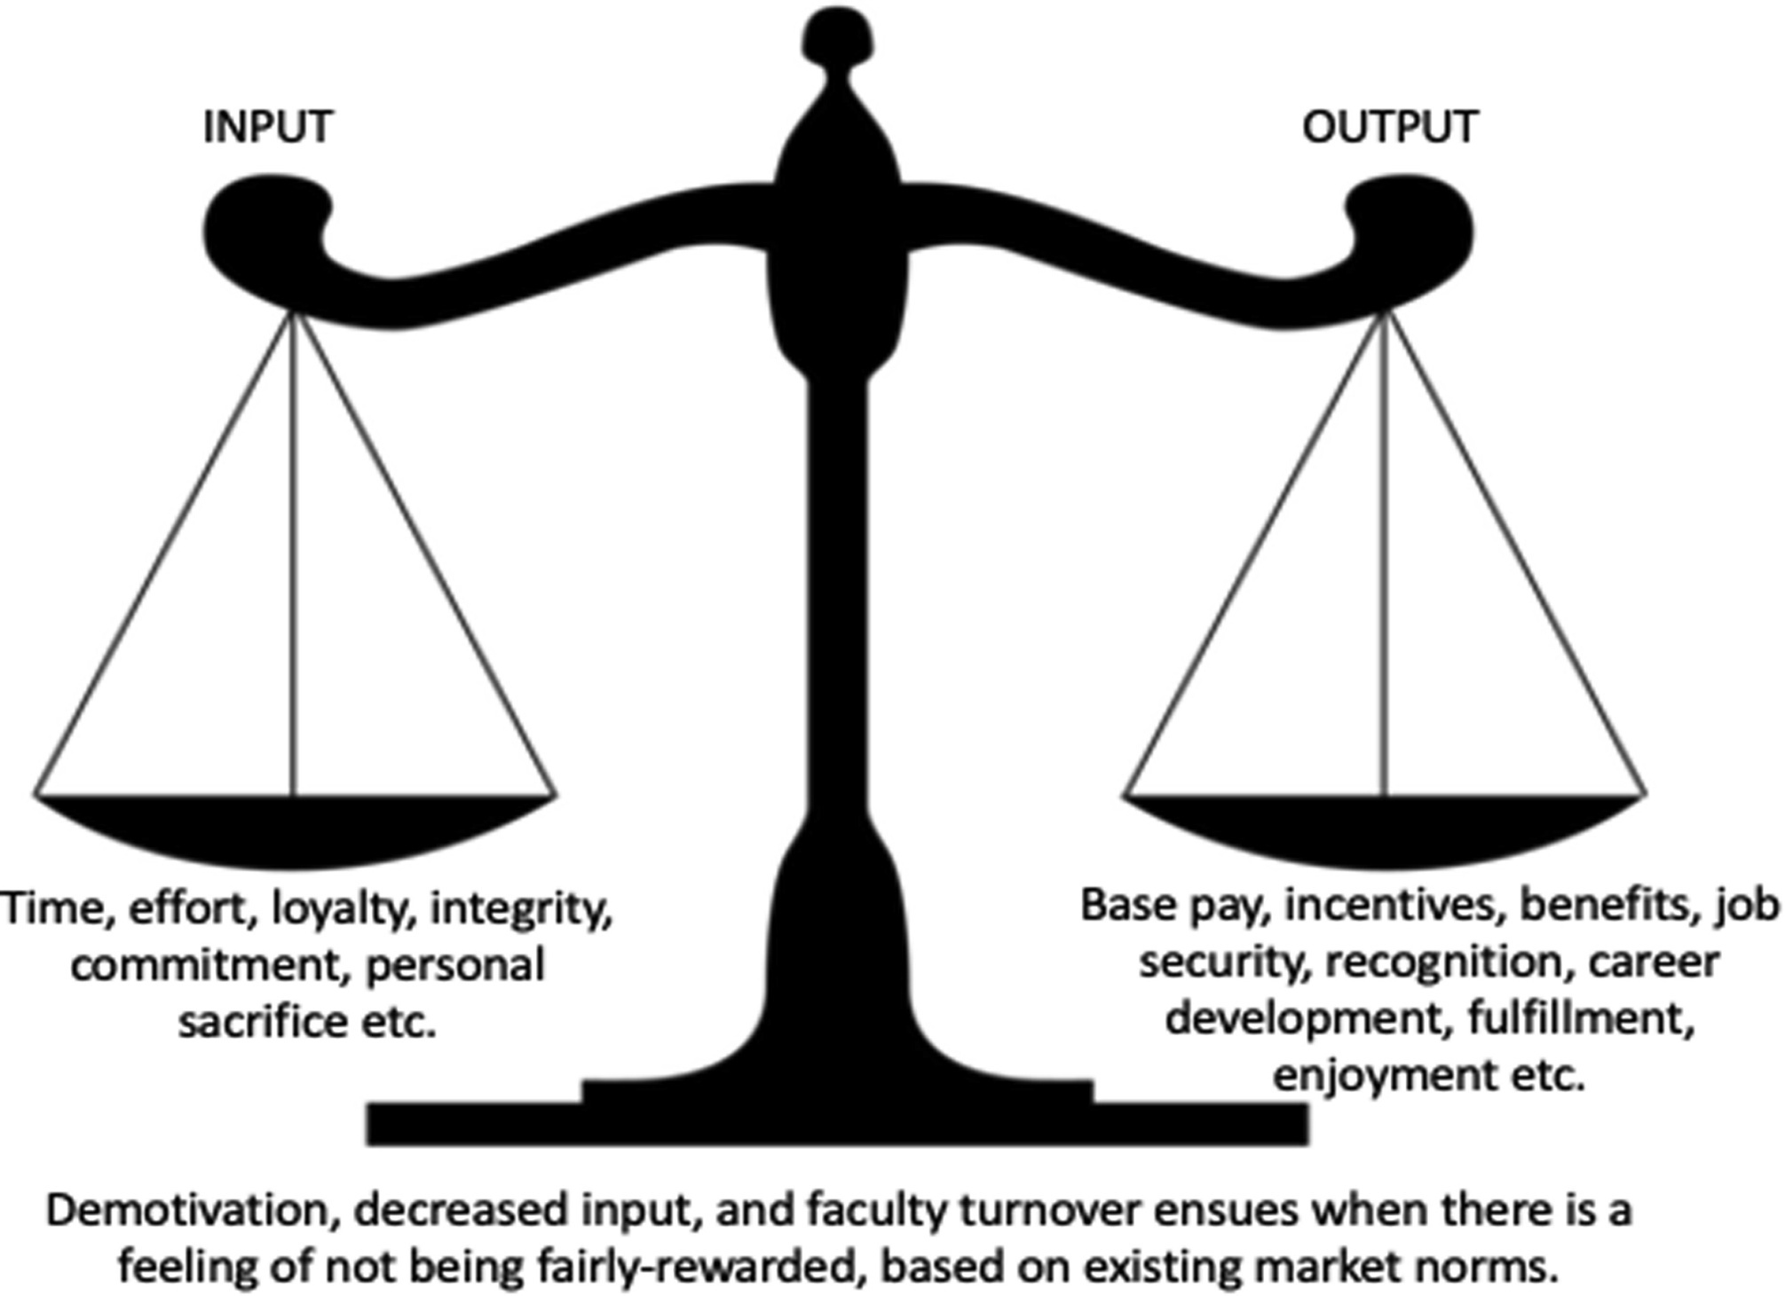

Slide 39
………….
Inputs
Effort
Time
Determination
Enthusiasm
Loyalty
Adaptability
Flexibility
Personal Sacrifice
Tolerance

Slide 40
…………
Output
Job security
Salary
Recognition
Praise
Employee benefit
Reputation

Slide 41
Expectancy Theory
Expectancy theory, initially put forward by Victor Vroom at the Yale School of Management, suggests that behavior is motivated by anticipated results or consequences.
Vroom proposed that a person decides to behave in a certain way based on the expected result of the chosen behavior.

Slide 42
How Expectancy Theory Works
Your tutor offers you £1 million if you memorise the textbook by tomorrow morning.
Expectancy
Instrumentality
Valence
Effort - Performance Link
Performance - Rewards Link
Rewards - Personal Goals Link
No matter how much effort
Your tutor does not look
There are a lot of wonderful things
you put in, probably not possible
like someone who has £1 million
you could do with £1 million
to memorise the text in 24 hours
E=0
I=0
V=1
Conclusion: Though you value the reward, you will not be motivated to do this task.

Slide 43
Work Motivation Theories: Expectancy Theory
praise from parents
good grades
graduate school
studying
lack of social life
good job
expectancies
less friends
instrumentalities
no fun
valences
effort
performance
outcome

Slide 44
Instrumentality
E P Expectancy or P O Theory Valence
What is the probability What is the probability What value do I place
that I can perform at that my good performance on the potential
the required level will lead to outcomes? outcomes? (see
if I try? next slide)
Effort Performance Outcomes
Notes:
14

Slide 45
Expectancy Theory
Involves 3 cognitions/perceptions:
1. Expectancy - the perceived probability that effort will
lead to task performance. E link
2. Instrumentality - the perceived probability that
performance will lead to rewards. I link
3. Valence - the anticipated value of a particular
outcome to an individual.
Effort Performance Rewards or
Outcomes
E link I link
Notes:
13

Slide 46
Vrooms expectancy theory -1964
Is applied to behavior at work
Employees motivation is a force driving him to achieve some level of job performance
Motivation is a product of values one seeks and ones expectation of the probability that certain action will lead to those values
Force or effort will depend upon his perception of the probability or likelihood of certain outcomes

Slide 47
MCQ
Which among the following theories can be considered as an extension of Maslows’ Need Hierarchy Theory of Motivation?
Alderfer – ERG theory
Maslow – hierarchy of needs theory
Herzberg – Two factor theory
Vroom’s expectancy theory

Slide 48
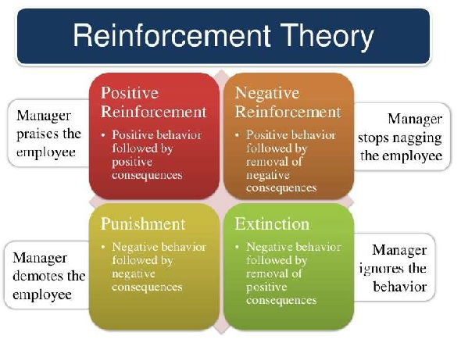

Slide 49
POSITIVE REINFORCEMENT
You positively react to someone’s behavior because it benefits your team and the organization. This also assures the individual to repeat their behavior and continue producing desirable outcomes.
For example, you can reward an employee for reaching office early

Slide 50
NEGATIVE REINFORCEMENT
Negative reinforcement refers to removing obstacles so that others can respond positively and perform the way that they’re expected to. For instance, if someone from your team wraps up early because of a long commute back home, you can ask them to take some projects home and allow them some flexibility

Slide 51
PUNISHMENT REINFORCEMENT
In this type of reinforcement, you impose a negative consequence or remove positive consequences to prevent someone from repeating undesirable behaviors. However, punishment doesn’t mean that you reprimand someone or criticize them harshly.
For example, suspending an employee for violating work rules

Slide 52
EXTINCTION REINFORCEMENT
It refers to the absence of reinforcements often used by managers to stop learned behavior. You withhold positive reinforcements or rewards that encouraged the behavior in the first place.
For example, your team is required to work overtime and even spare their weekends. After the completion of the project, you stop providing any incentives and soon this learned behavior of working overtime ends.

